Slide 1
GAIT Recognition using Deep Learning
Utkarsh Singh Samar Pratap Singh Kriti Chapagain
18BCE2139 18BCE2169 18BCE2483

Slide 2
ABSTRACT
Gait recognition is a branch of biometric identification that focuses on detecting individuals using personal measures and relationships, such as trunk and limb size, as well as space-time information connected to inherent patterns in individuals' motions. In the context of surveillance systems or foggy environment monitoring, for example, where distinctive elements commonly used for biometric identification, such as the fingerprint and face, are difficult or impossible to differentiate, such an approach has proven to be quite effective.
Furthermore, compared to other biometric identification models, gait recognition systems have certain advantages because hacking such designs is difficult.
The challenge stems mostly from the concept's inherent properties, namely, identification based on the silhouette and its mobility, which is particularly difficult to reproduce. The same cannot be said for other strategies, such as disguising one's face from the system. Furthermore, gait recognition models do not require high-resolution photos or specific equipment, such as iris and fingerprints, for proper identification. Furthermore, while other methods require the studied person to engage with the identifying system, gait recognition methods do not require individual interaction.

Slide 3
To achieve identity authentication, gait recognition primarily leverages the varied postures of each individual. The full-cycle gait photos are used for feature extraction in previous approaches, but there are issues such as occlusion and frame loss in the actual scene. A full-cycle gait image is difficult to come by. As a result, the focus of gait recognition research has shifted to how to build a highly efficient gait recognition algorithm framework based on a small number of gait photos in order to enhance recognition efficiency and accuracy.
The CRBM+FC deep neural network is constructed in this chapter. A method of learning gait identification from GEI to output is provided based on the properties of Local Binary Pattern (LBP) and Histogram of Oriented Gradient (HOG) fusion. It is suggested a brand-new gait detection algorithm based on the layered fu-sion of LBP and HOG. This chapter also offers a feature learning network that trains Gait Energy Images using an unsupervised convolutional restricted Boltzmann machine (GEI).

Slide 4
Introduction
Gait information is easily collected from distance, which stands for an enormous advantage regarding other techniques, especially when the identification is not assisted by the analyzed person, e.g., criminal investigations. Besides, since it does not require sophisticated equipment for data extraction, these methods are commonly cheaper than other approaches, majorly due to the popularization of surveillance systems and the advent of cell phones equipped with accelerometers, which transformed the burden of extracting data signals into a straightforward task.
Despite the simplicity regarding the tools mentioned above, identifying people by walking and moving is far from a trivial task. Standard gait recognition methods, i.e., which comprise data pre-processing and features extracted in a handcrafted fashion for further recognition, often suffer from several constraints and challenges imposed by the complexity of the task, such as viewing angle and large intra-class variations, occlusions, shadows, and locating the body segments, among others. A new trend on machine learning, known as deep learning, emerged in the last years as a revolutionary tool to handle topics in image and sound processing, computer vision, and speech, overwhelmingly outperforming virtually any baseline established until then. The new paradigm exempts the necessity of manually extracting representative features from experts and also provides paramount results regarding gait recognition, surpassing existing challenges and opening room for further research.

Slide 5
Objective
The objective is to explore machine learning techniques and understand their pros and cons on employing gait patterns for authenticating users. This system is one of the distinctive attributes. Using a database which consists of multiple types of behaviors such as; running, walking, standing and sitting.
The main objectives of this work are three-fold:
To systematically introduce the most recent and significant works comprising strategies for gait recognition through deep learning approaches; and
To provide the reader with a substantial and illustrated theoretical background regarding gait recognition, exploring its roots on biometric recognition and exposing the most popular tools employed to gait feature extraction and the architectures used to tackle the associated constraints; and
To present an illustrated, categorized, and characterized catalog of the public datasets available for the task of gait recognition.

Slide 6
PROBLEM STATEMENT
Many biometrics, e.g., the fingerprint, iris, face, and voice etc., have been implemented commercially. Some of these biometrics are obtrusive to users as they require the cooperation of users to collect the data. For example, users are asked to place a finger on a device to have their fingerprints captured or to look at a camera close enough to have their irises imaged. In such cases, a user may feel offended and easily realizes that his/her identity is being checked.
Meanwhile, some biometrics are easily forged and attacked. For example, face recognition can be cheated by using an image or a video of the target face As a result, less obtrusive and more robust biometrics are currently in great demand. Unobtrusiveness is especially important for a biometric system that must work in a discrete manner, e.g., to recognize the identity of a person but not to let him/her know he/she is being identified. Among various biometrics, gait not only satisfies the requirement of being unobtrusive but also is more difficult to conceal.

Slide 7
LITERATURE REVIEW
Deep learning showed much success in the area of machine learning in the past two decades. Well known applications of deep learning include visual surveillance, biometrics, and medicine, among others. Biometrics is an important application and much research attends to this field. In the biometric field, gait recognition is an important research area and several techniques using deep learning have been introduced.
Davarzani et al. presented a system for human gait detection based on deep learning. They implemented three models at the initial stage such as linear regression, artificial neural network (ANN), and LSTM. Later on, the performance of each model was combined for the final detection. The experimental process was conducted on each model using publically available datasets. The results showed that the ANN performed well as compared to linear regression and LSTM. Asif et al. presented an end-to-end system based on pre-trained convolutional neural network features and best features selection. They used deep learning for the deep features extraction, and then best features were selected for the final classification. The results showed that the precision and recall rate of the presented method was better than the current state-of-the-art methods.

Slide 8
Anusha et al. described a Modified Local Optimal Oriented Pattern Binary (MLOOPB) descriptor for clothing-invariant HGR. The MLOOPB descriptors were the extension of LOOP descriptors. From MLOOPB, different types of feature vectors such as the histogram and horizontal width variables were extracted. Then, the extracted features were reduced using a new approach, and classification was performed. The experimental process was conducted on the OU-ISIR B treadmill gait dataset and the CASIA B gait dataset and showed improved accuracy over the compared techniques. Habiba et al. presented an integrated framework for HGR using deep features and a hybrid feature selection method. They employed pre-trained models for deep features extraction. The extracted features were selected using a fuzzy entropy controlled skewness (FEcS) approach. Four popular datasets were used for the experimental process, CASIA A, CASIA B, CASIA C, and AVAMVG and showed better performance than existing techniques.

Slide 9
Kooksung et al. presented an automated feature extraction approach using a recurrent neural network (RNN)-based auto encoder (AE) for skeleton-based abnormal gait identification. They introduced two models named gated recurrent unit (GRU)-based AE (GRU AE) and an LSTM-based AE (LSTM AE). Using these two models, they extracted deep features and performed identification. Based on the experimental process, it was noted that the LSTM AE outperformed the GRU AE in terms of efficiency for gait identification. Anusha et al. extracted low-dimensional features such as gradient, spatial, and texture for gait recognition. They used a nine-cell gait gradient magnitude image to compute a histogram of oriented gradients. After that, Haralick texture descriptors were extracted and concatenated for final recognition. The experiment was carried out on five gait datasets and obtained better accuracy than the existing compared techniques.

Slide 10
Khan et al. presented a cross-view gait identification using a view-invariant gait representation model. They trained a deep fully connected neural network to convert gait descriptors from different points of view into a single canonical view. Later, the single canonical view descriptors were used for the experimental process. The experimental process was conducted on the OU-ISIR large population and CASIA-B datasets and showed that the presented cross-view gait recognition method had improved accuracy. Elharrouss et al. presented a deep learning structure for HGR. They used multitask CNN architectures and extracted gait energy images (GEIs). Based on the GEI, features were extracted that were later classified using CNN. The experimental process was conducted on the CASIA B, OU-ISIR, and OU-MVLP datasets. The results on the selected datasets were better than current methods.
A few other studies were also conducted for HGR, such as PoseGait and the CNN model , a multichannel CNN architecture, GEI and CNN architecture , and RCNN based gait recognition, among others . The methods mentioned focused on the middle step, for example, GEI, handcrafted features, and CNN. They did not focus on the important steps of the fusion of features from different models and selecting the best features for better computational time. This article proposes a new framework using deep learning features selection and multisource features fusion for HGR.

Slide 11
Progress after review 2
System Architecture
Methodology Adapted
Implementation
Expected Result with discussions
Details of Hardware and software
Gait recognition module improved

Slide 12
System Architecture
The network takes raw RGB video frames of a pedestrian as an input and produces one-dimensional vector - gait descriptor that exposes as an identification vector.
Whole network consists of two sub-networks connected in cascade - HumanPoseNN and GaitNN.
Spatial features from the video frames are extracted according to the descriptors that involve pose of the pedestrian. These descriptors are generated from the first sub-network - HumanPoseNN defined in human_pose_nn module. HumanPoseNN can be also used as a standalone network for regular 2D pose estimation problem from still images.

Slide 13
Methodology ADAPTED
The system takes the input video sequence.
HumanPoseNN estimates the pose of the Input data.
The pose descriptor in the GaitNN takes the each pose sequence.
The data from the pose descriptor is processed to Recurrent cell, which passes it to the Temporal averaging pooling.
All temporal features are finally aggregated with Average temporal pooling into one-dimensional identification vector with good discriminatory properties.

Slide 14
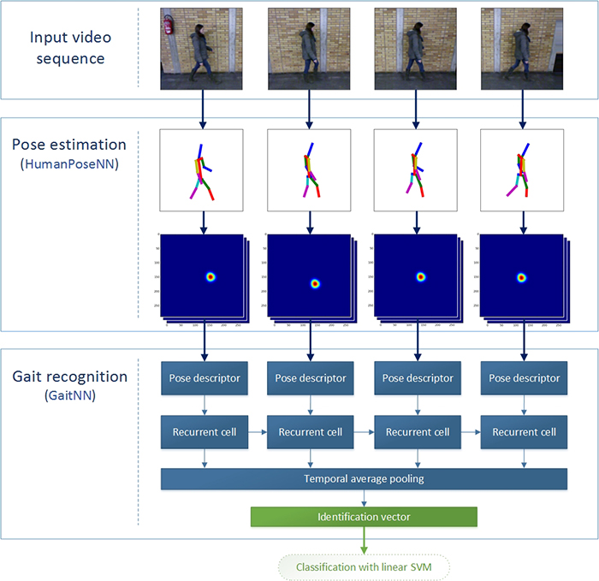

Slide 15
IMPLEMENTATION
INPUT DATA
POSE ESTIMATION
GAIT RECOGNITION

Slide 16
Input Data :
video_frames
Gait Recognition:
The dummy code shows how to generate the identification vector form the input data video_frames.
Pose Estimation:
The first sub-network HumanPoseNN can be also used as a standalone network for 2D pose estimation problem.

Slide 17
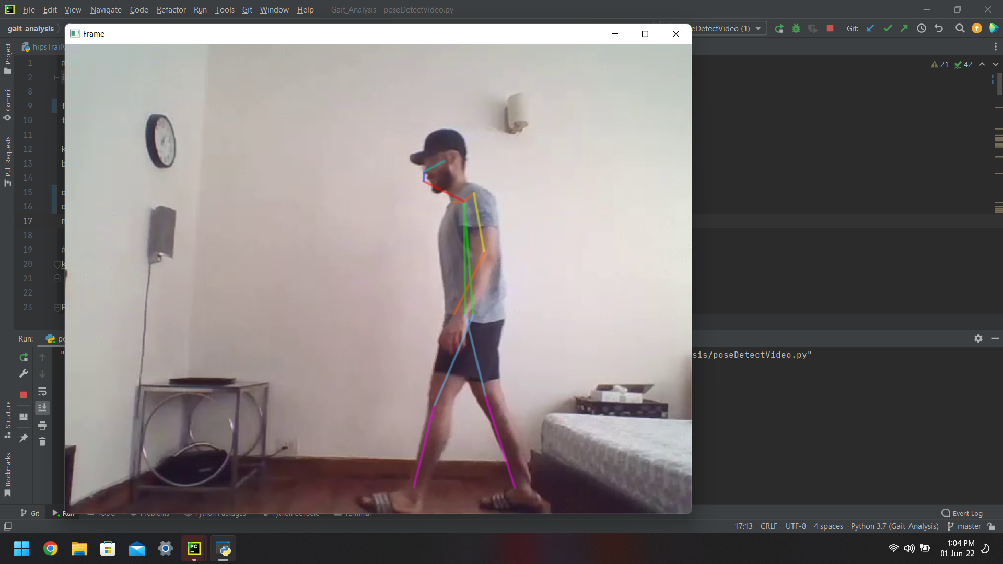
EXPECTED RESULTS
Dummy Pose Estimation:
After we run the dummy_pose_estimation.py, our dummy pose which we have in
Images/dummy.jpg will be estimated and probability of each estimate is printed.

Slide 18
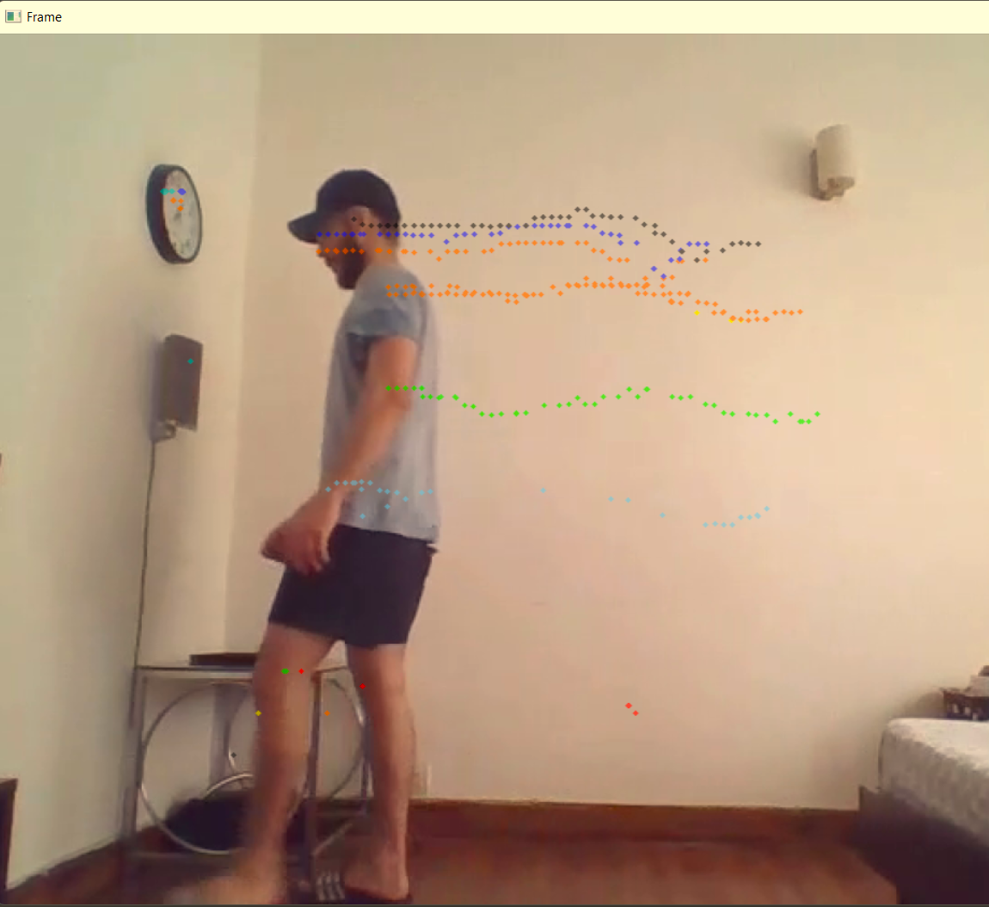

Slide 19
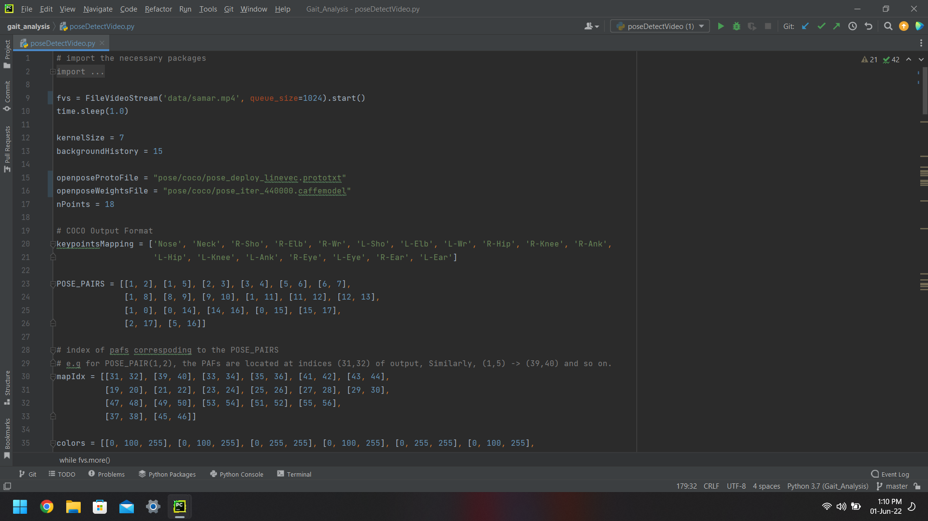

Slide 20
Codes and Standards
Wearable Sensors: WS are an obvious approach to collect human gait due to their comfort, efficiency and decrease price. in contrast to different gait capturing structures, WS impose upon the person to cooperate sporting the tool in a non-invasive way to provide gait signals. The advances in digital gadgets and sign processing techniques have extended the packages of WS sensors to produce a dimension of human frame orientation, function and precise pressure in space and time. The inertial size unit (IMU) is a kind of WS system that has been significantly used because of its small size, fee, mild weight, and precise precision traits. a typical IMU affords the most widely used combination of sensing modalities to seize human sports, together with gait. It accommodates of an accelerometer, a gyroscope and regularly a magnetometer, which gives the heading course. extra additives including batteries, microprocessors and verbal exchange modules are arranged to together function an IMU system. Gyroscope sensors measure the angular pace as the rate of exchange of the sensor’s orientation, while accelerometer sensors degree the acceleration of the frame resulting from the acting forces in the contrary course. A aggregate of these sensors can create a comprehensive report on the human body orientation, gravitational forces, speed and acceleration.

Slide 21
SOFTWARE REQUIREMENTS
Python3.5
Python Packages:
TensorFlow - primarily for deep learning applications.
Numpy - supplies an enormous library of high-level mathematical functions that operate on these arrays and matrices.
Scipy - allows users to manipulate the data and visualize the data using a wide range of high-level Python commands.
PIL - modules for image processing in Python

Slide 22
PRE TRAINED MODELS
HumanPoseNN
GaitNN

Slide 23
conclusion
Gait recognition is a biometric technique that aims to determine the identity of humans based on the style and manner of their walk. In this paper, we developed a specialized deep CNN model, which consists of many layers, for human gait recognition. The advantage of the deep CNN is its ability to extract discriminative features and better classification, especially if the available training dataset is large. We empirically determined the appropriate architecture of the deep CNN for gait recognition. The proposed CNN is capable of overcoming many problems associated with gait recognition, especially when covariate factors are involved, and hence leads to better gait recognition performance. Several different experimental results on the databases demonstrate that the proposed deep CNN model can obtain competitive performance.

Slide 24
references
Yao, T.; Gao, F.; Zhang, Q.; Ma, Y. Multi-feature gait recognition with DNN based on sEMG signals. Math. Biosci. Eng. 2021, 18, 3521–3542. [Google Scholar] [CrossRef]
Steinmetzer, T.; Wilberg, S.; Bönninger, I.; Travieso, C.M. Analyzing gait symmetry with automatically synchronized wearable sensors in daily life. Microprocess. Microsyst. 2020, 77, 103118. [Google Scholar] [CrossRef]
Mei, C.; Gao, F.; Li, Y. A determination method for gait event based on acceleration sensors. Sensors 2019, 19, 5499. [Google Scholar] [CrossRef] [PubMed]
Luo, R.; Sun, S.; Zhang, X.; Tang, Z.; Wang, W. A low-cost end-to-end sEMG-based gait sub-phase recognition system. IEEE Trans. Neural Syst. Rehabil. Eng. 2019, 28, 267–276. [Google Scholar] [CrossRef] [PubMed]
Liao, R.; Yu, S.; An, W.; Huang, Y. A model-based gait recognition method with body pose and human prior knowledge. Pattern Recognit. 2020, 98, 107069. [Google Scholar] [CrossRef]
Addabbo, P.; Bernardi, M.L.; Biondi, F.; Cimitile, M.; Clemente, C.; Orlando, D. Temporal convolutional neural networks for radar micro-Doppler based gait recognition. Sensors 2021, 21, 381. [Google Scholar] [CrossRef]
Khan, M.A.; Khan, M.A.; Ahmed, F.; Mittal, M.; Goyal, L.M.; Hemanth, D.J.; Satapathy, S.C. Gastrointestinal diseases segmentation and classification based on duo-deep architectures. Pattern Recognit. Lett. 2020, 131, 193–204. [Google Scholar] [CrossRef]

Slide 25
Khan, M.A.; Kadry, S.; Parwekar, P.; Damaševičius, R.; Mehmood, A.; Khan, J.A.; Naqvi, S.R. Human gait analysis for osteoarthritis prediction: A framework of deep learning and kernel extreme learning machine. Complex Intell. Syst. 2021, 1–19. [Google Scholar] [CrossRef]
Arshad, H.; Khan, M.A.; Sharif, M.; Yasmin, M.; Javed, M.Y. Multi-level features fusion and selection for human gait recognition: An optimized framework of Bayesian model and binomial distribution. Int. J. Mach. Learn. Cybern. 2019, 10, 3601–3618. [Google Scholar] [CrossRef]
Farnoosh, A.; Wang, Z.; Zhu, S.; Ostadabbas, S. A Bayesian Dynamical Approach for Human Action Recognition. Sensors 2021, 21, 5613. [Google Scholar] [CrossRef]
Shiraga, K.; Makihara, Y.; Muramatsu, D.; Echigo, T.; Yagi, Y. Geinet: View-invariant gait recognition using a convolutional neural network. In Proceedings of the 2016 International Conference on Biometrics (ICB), Halmstad, Sweden, 13–16 June 2016; pp. 1–8. [Google Scholar]
Liu, J.; Zheng, N. Gait history image: A novel temporal template for gait recognition. In Proceedings of the 2007 IEEE International Conference on Multimedia and Expo, Beijing, China, 2–5 July 2007; pp. 663–666. [Google Scholar]
Lv, Z.; Xing, X.; Wang, K.; Guan, D. Class energy image analysis for video sensor-based gait recognition: A review. Sensors 2015, 15, 932–964. [Google Scholar] [CrossRef]
Chen, K.; Wu, S.; Li, Z. Gait Recognition Based on GFHI and Combined Hidden Markov Model. In Proceedings of the 2020 13th International Congress on Image and Signal Processing, BioMedical Engineering and Informatics (CISP-BMEI), Chengdu, China, 17–19 October 2020; pp. 287–292. [Google Scholar]
Liu, S.; Wang, X.; Zhao, L.; Li, B.; Hu, W.; Yu, J.; Zhang, Y. 3DCANN: A Spatio-Temporal Convolution Attention Neural Network for EEG Emotion Recognition. IEEE J. Biomed. Health Inform. 2021. [Google Scholar] [CrossRef]
Wang, S.; Celebi, M.E.; Zhang, Y.-D.; Yu, X.; Lu, S.; Yao, X.; Zhou, Q.; Miguel, M.-G.; Tian, Y.; Gorriz, J.M. Advances in Data Preprocessing for Biomedical Data Fusion: An Overview of the Methods, Challenges, and Prospects. Inf. Fusion 2021, 76, 376–421. [Google Scholar] [CrossRef]

Slide 26
Thank you

